Slide 1

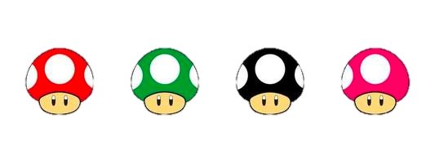
Card Sorting
Workshop by
Cerys
Oz
Luke
Laura
Alex
Godline Art, Vecteezy. (2022).
[Digital Image]

Slide 2
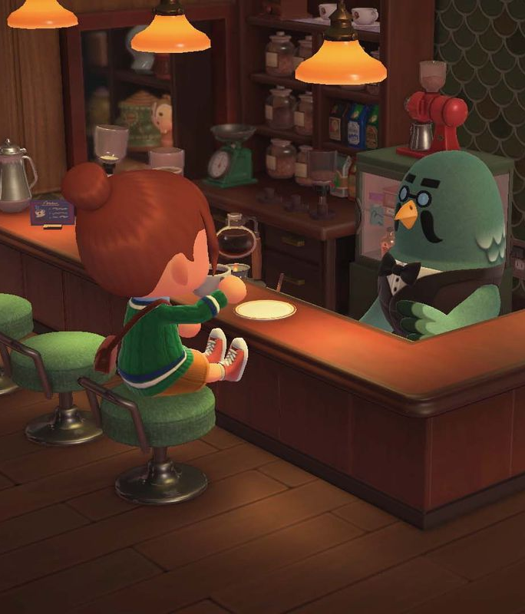
Warm-up task
Take a few minutes with your table to organize the given items how you see fit.
We will then come back to discuss your choices and reasoning behind it.
‌’How to unlock Brewster and The Roost - Animal Crossing: New Horizons Guide’ (2021) Polygon [Digital Image] [online].

Slide 3
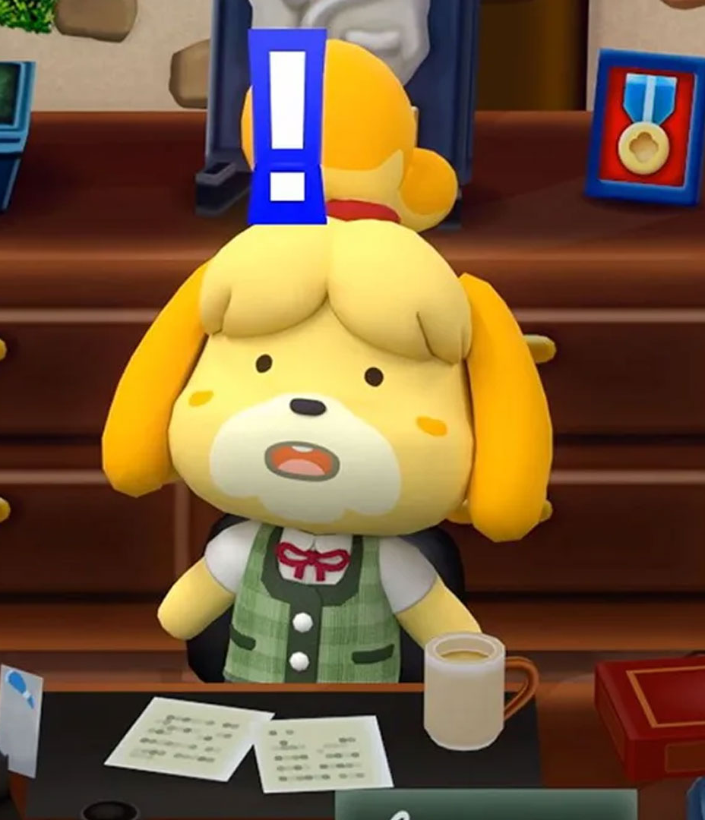
What did you just do?
You just sorted some cards; this is one of the steps towards the main goal of card sorting.
After this workshop, you will have learned:
The fundamentals of card sorting
How to apply critical decisions within a given context
Another method of gaining user feedback
Understand the different types of card sorting
‌Wald, H. (2020) Animal Crossing: New Horizons preorder delays affecting some customers - check yours now!
[Digital Image]

Slide 4

What is card sorting?
Card sorting is a research method where users are asked to order elements into a hierarchical order in which the user deems most efficient. This information will then later be used to enhance a product.
‘Professor Oak - Bulbapedia, the community-driven Pokémon encyclopedia’ (2023) [Digital Image].

Slide 5
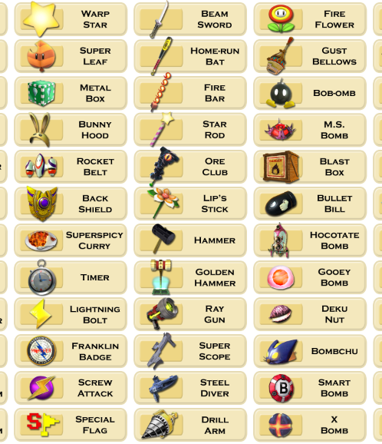
Open Card Sorting
Users group topics into categories that make personal sense to them. They can then make their own name for each grouping.
This allows new ideas to be introduced and a deeper, more focused understanding of the users.
Top 10 Worst ‘Super Smash Bros.’ Items (2016) Wordpress [Digital Image] [online].

Slide 6
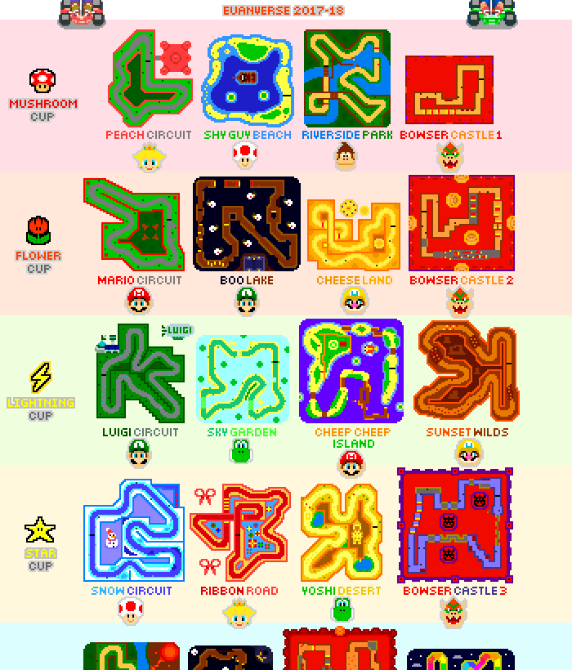
Closed Card Sorting
Users are given pre-named sets of categories and are tasked with sorting them to what makes the most sense to them, still being within the preset guidelines.
This type of sorting allows existing structures to assess if they are completely understood within users, as well as verify ways to improve the information architecture.
‘Mario Kart 64 Tracks’ (2019) DeviantArt [Digital Image] [online]

Slide 7
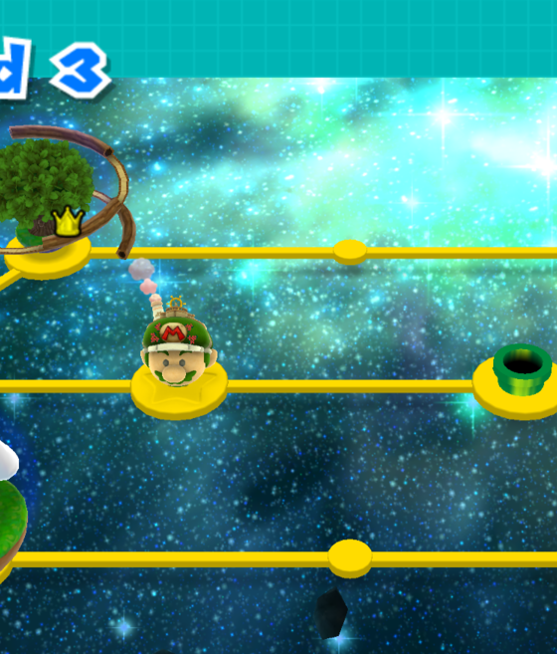
Hybrid Card Sorting
‘World 3 (Super Mario Galaxy 2)’ (2022) MarioWiki [Digital Image] [online]
A combination of open and closed sorting, hybrid sorting allows existing structures and categories to be tested while still allowing outside ideas from users to be considered.
This method is useful for when extra information is still needed to be categorized, but you do not know where it would fit within the existing categories.

Slide 8
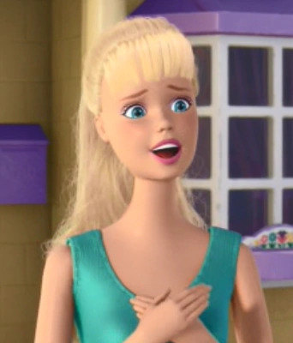
Barbie: An example
Mattel, Inc. used card sorting to help redesign their showcase website for Barbie. The website is used for people to show off their current collection.
Mattel gathered a group of 9 participants to help narrow down what is most important to the users. The group was given 2 separate lines to organize into themes:
1. An existing line
2. Fashion-focused line
After the research they concluded that a single method of search wasn’t an option. Resulting in a multilayered website that allows users to browse by their choice rather than a single given option.
Toy Story 2 (2010) Barbie Screenshot
Maze (2020) 7 Card sorting examples to inform your UX research.

Slide 9
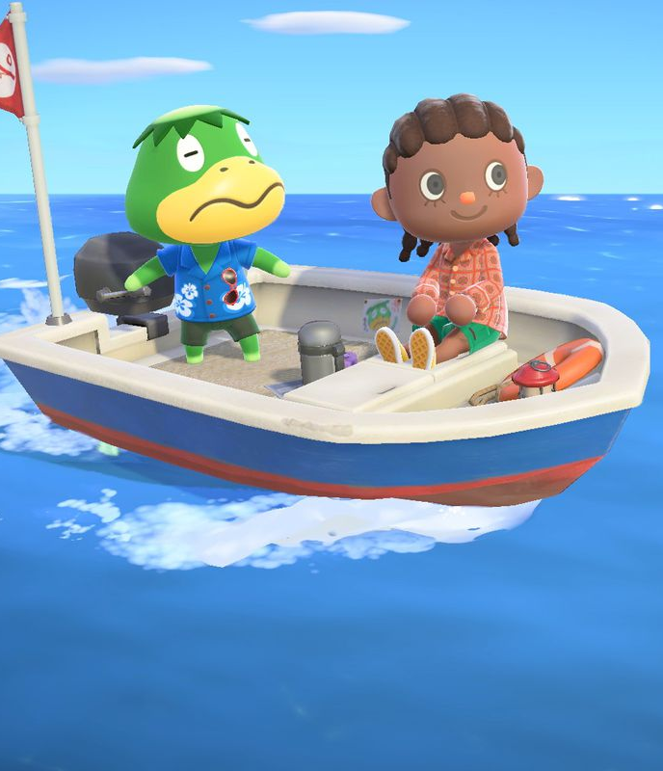
Task
You are now on the S.S. Seas the Opportunity and you’re heading back to the UK from Canada across the North Atlantic Ocean. Imagine your boat has got a hole and it’s starting to sink! You have less than 5 minutes to grab things to bring on the lifeboat with you.
On the tables you are sat on, using the same cards used in the first task, organize your items under the categories now on your tables, max of 4 items in each category.
S.S. Seas the Opportunity
Lee, J. and Carpenter, N. (2021) Kapp’n and his islands in ACNH Polygon.
[Digital Image]

Slide 10
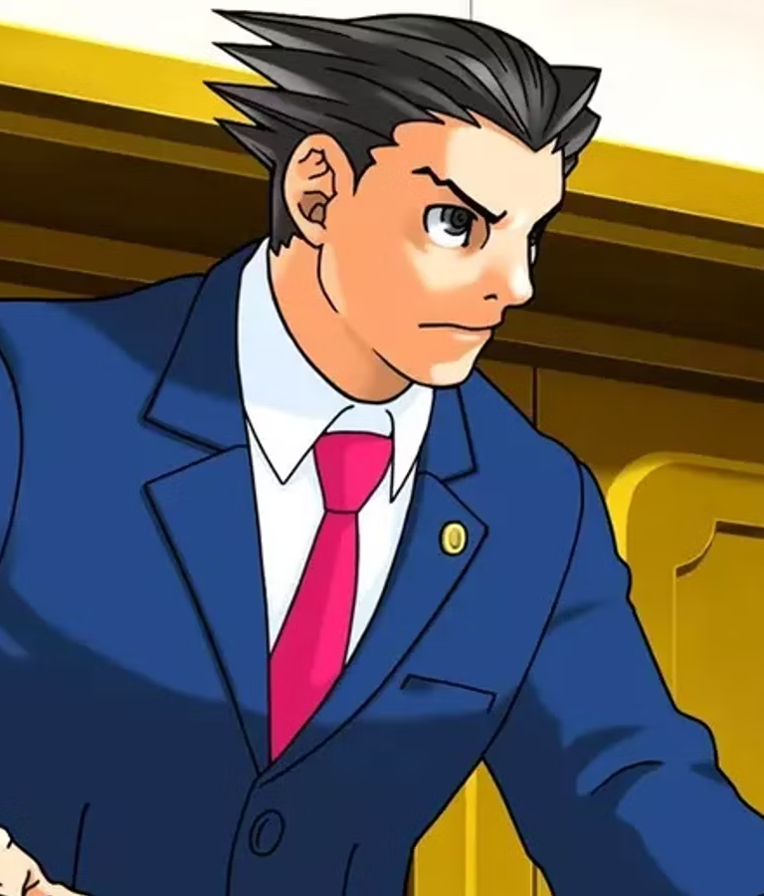
Open discussion
Why did you put them where you did?
‘How the Ace Attorney Games Basically Locked Down the Visual Novel Genres (2023) GameRant [Digital Image] [online]

Slide 11
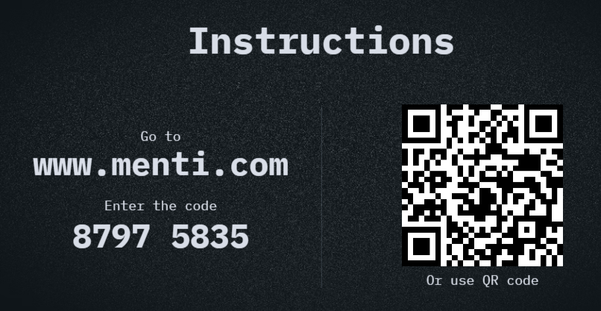
Quiz Time

Slide 12

Lightning round
You now have post-its on your table, decide within your groups whether to add new categories or maybe even remove categories from the previous task. No limitations!
You have 2 minutes… CATEGORISE!
What did you change?
‘Lightning’ (2023) MarioWiki [Digital Image] [online]

Slide 13
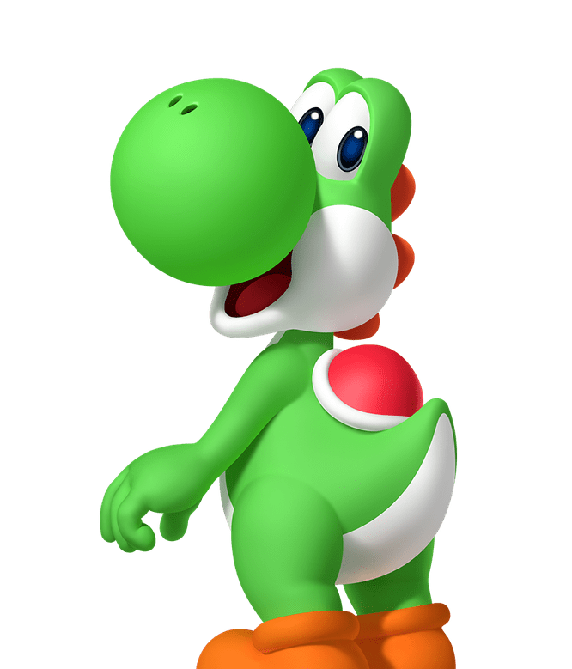
Questions?
Learn more about Yoshi at Play Nintendo (2022) [Digital Image]

Slide 14
References
Godline Art, Vecteezy (2022). Super Mario Mushroom vector on white background. [Digital Image ].15 March 2022 [online]. Available from: https://www.vecteezy.com/vector-art/6549212-super-mario-mushroom-vector-on-white-background [Accessed 24 January 2023].
‘How the Ace Attorney Games Basically Locked Down the Visual Novel Genres (2023) GameRant [Digital Image] [online] Available from: https://gamerant.com/ace-attorney-capcom-visual-novel-genre-success-story-action-mechanics/ [Accessed 22 January 2023]
‌’How to unlock Brewster and The Roost - Animal Crossing: New Horizons Guide’ (2021) Polygon [Digital Image] [online]. Available from: https://www.polygon.com/animal-crossing-new-horizons-switch-acnh-guide/22740479/brewster-the-roost-unlock-coffee-museum-cafe-invite-friends-amiibo-cards [Accessed 22 January 2023]
‘Learn more about Yoshi at Play Nintendo’ (2022) [Digital Image] Nintendo.com.2022 [online]. Play Nintendo. Available from: https://play.nintendo.com/themes/friends/yoshi/ [Accessed 24 January 2023].
Lee, J. and Carpenter, N. (2021) Kapp’n and his islands in ACNH Polygon.22 October 2021 [Digital Image] [online]. Polygon. Available from: https://www.polygon.com/animal-crossing-new-horizons-switch-acnh-guide/22740930/kappn-boat-tours-unlock-find-missing-pier-island-nook-miles-ordinances-three-star-rating-kk-slider [Accessed 24 January 2023].
‘Lightning’ (2023) MarioWiki [Digital Image] [online] Available from: https://www.mariowiki.com/Lightning [Accessed 22 January 2023)
‘Mario Kart 64 Tracks’ (2019) DeviantArt [Digital Image] [online] Available from: https://www.deviantart.com/euanverse/art/Mario-Kart-64-Tracks-808014033 [Accessed 22 January 2023]
Maze (2020) 7 Card sorting examples to inform your UX research. Available from: https://maze.co/guides/card-sorting/card-sorting-examples/ [Accessed 5 December 2022].
‘Professor Oak - Bulbapedia, the community-driven Pokémon encyclopedia’ (2023) Bulbagarden.net.2023 [Digital Image] [online]. Available from: https://bulbapedia.bulbagarden.net/wiki/Professor_Oak [Accessed 24 January 2023].
Top 10 Worst ‘Super Smash Bros.’ Items (2016) Wordpress [Digital Image] [online]. Available from: https://creamerscinemacraze.wordpress.com/2016/05/15/top-10-worst-super-smash-bros-items/ [Accessed 22 January 2023]
Toy Story 2 (2010) Barbie Screenshot [Digital]. At: Wiki Disney Fandom [online].Available from: https://disney.fandom.com/wiki/Barbie [Accessed 04 December 2012].
‌Wald, H. (2020) Animal Crossing: New Horizons preorder delays affecting some customers - check yours now! 19 March 2020 [Digital Image] [online]. GamesRadar+. Available from: https://www.gamesradar.com/animal-crossing-new-horizons-preorder-delays/ [Accessed 23 January 2023].
‘World 3 (Super Mario Galaxy 2)’ (2022) MarioWiki [Digital Image] [online] Available from: https://www.mariowiki.com/World_3_%28Super_Mario_Galaxy_2%29 [Accessed 22 January 2023]

